Slide 1
Policy Voter
Presentation 2
PJ Ofremu, James Leonard, Chris Chheang, Jason Chong

Slide 2
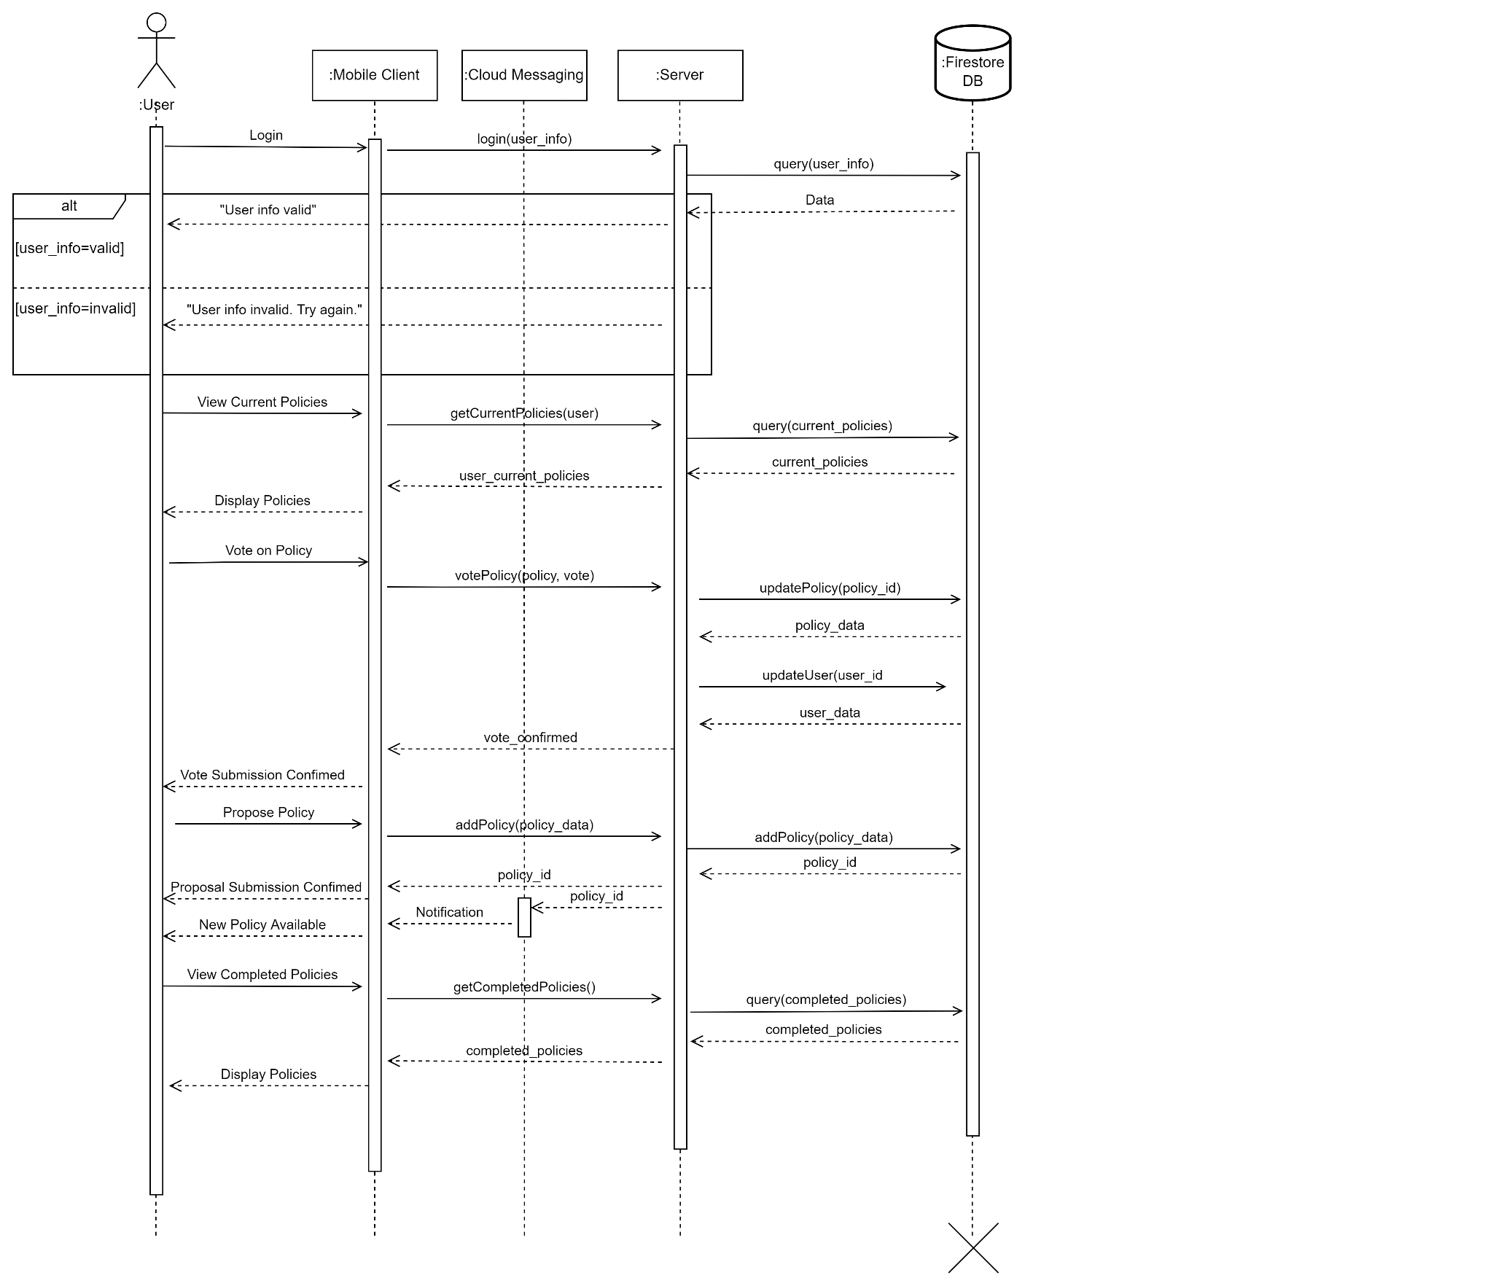
UML Sequence Diagram

Slide 3
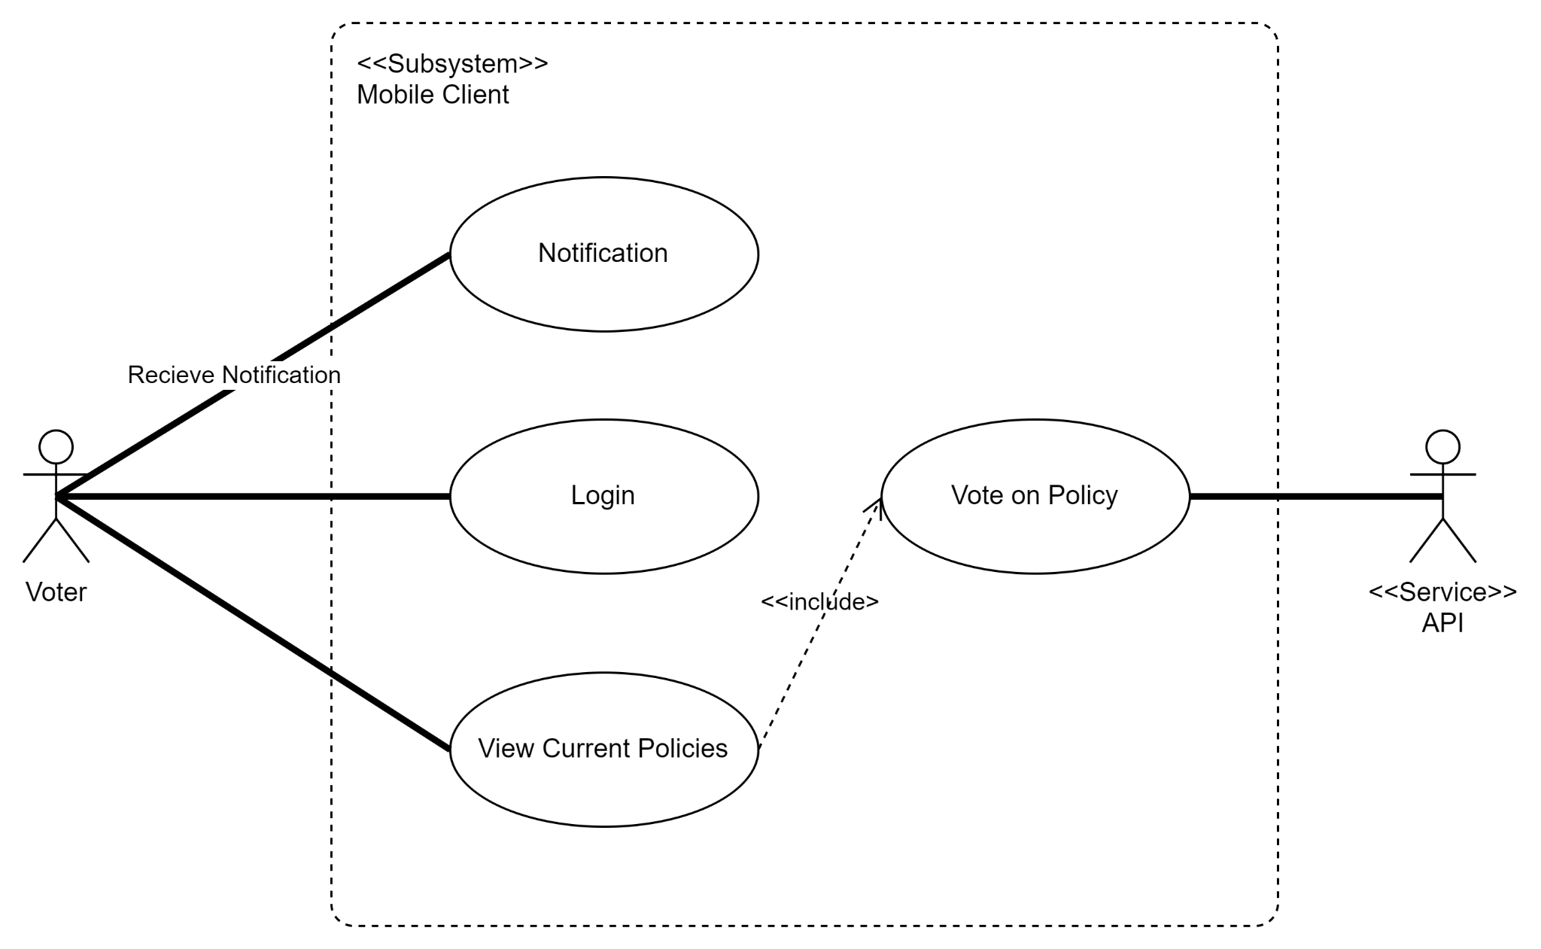
Use Case: Vote on Policy

Slide 4
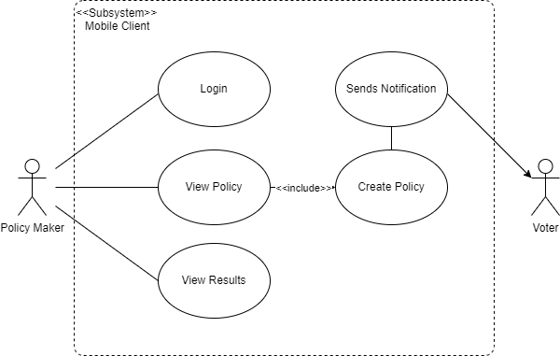
Use Case: Propose Policy

Slide 5
Test Scenario 1
Jim is a committee member and wants to propose a new policy. He opens the Policy Voting app on his mobile device. He is first shown the login page, he enters his username and password. If the credentials are invalid he is prompted to re-enter the information. If the credential are valid a “successful login” is shown on the screen and he directed to the voter portal of the app.
Once here he clicks the button in the top right of the screen on the “Propose Policy” button. A new page is with text fields for him to enter the policy title and policy description. Once he fills in all the fields he hits the submit button. It will prompt him with a confirmation prompt, if he reconfirms, the policy data is sent to the server. The server inserts the new policy into the database and send a confirmation message back to the policy writer
All committee members who have the app installed to their phone receive a notification about the new policy and his app redirects him back to the voter portal where his new policy “Keep the Food Away” will be at the top. He will tap on the policy in the app and vote for it, after that it will no longer appear in the app for himself. His policy will remain listed and open for voting on the app til all the available users in the app have cast a vote.
Notes:
Point out piece that are being tested
- Mobile client request to insert new policy to server
- Server send back confirmation of successful insertion
- Notification sent to all users of new policy

Slide 6
Test Scenario 2
Jennie presses the new policy called “Keep the Food Away”. On the next page, she reads the policy description. She presses the reject button and a confirmation prompt pops up confirming her vote. Originally, she was going to click yes but then she changed her mind and pressed no. It brings her back to the voting page and this time, she presses accept. Lastly, she hits yes to confirm her vote and is returned to the voter portal. Jennie’s vote data is stored in the database and the voter count is updated. If Jennie’s vote is the last vote, the policy status is set to “Completed” and all users can view the results
Jennie was on her phone when a notification popped up. The notification stated that a new policy had been created and needed to be voted on. She opens the Policy Voting app and inputs her username and password into the login page. Then, she clicks login but an error message, “login unsuccessful” appears. She re-enters her credentials and the app returns “login was successful”.
The voter portal with a list of new and past policies was shown. Jennie clicks on a past policy to view the policy description and the results of this policy. She presses the back button to return to the voter portal to view the newest policy created.
Notes:
Point out piece that are being tested
- Mobile client request for current policies
- Server send back confirmation of successful vote
- Server update status of policy vote

